Slide 1
QSCOUT
OCTET:RFSoC

Slide 2
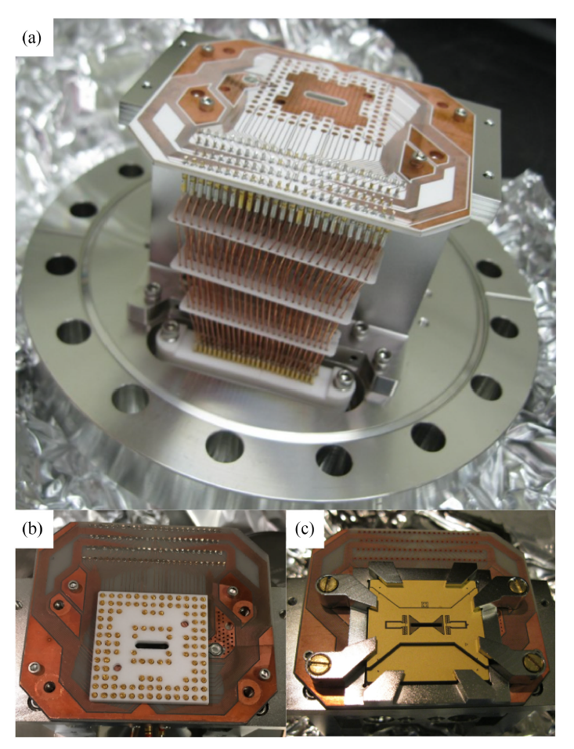
Trap Configuration
S. M. Clark, D. Lobser, M. C. Revelle, C. G. Yale, D. Bossert, A. D. Burch, M. N. Chow, C. W. Hogle, M. Ivory, J. Pehr, B. Salzbrenner, D. Stick, W. Sweatt, J. M. Wilson, E. Winrow, and P. Maunz, IEEE Transactions on Quantum Engineering 2, 1 (2021).

Slide 3
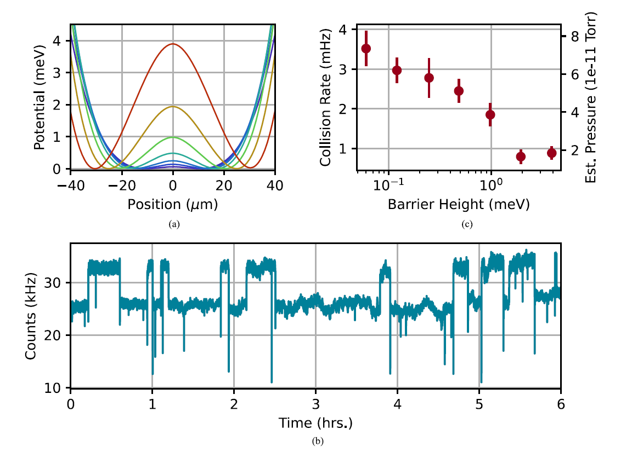
Pressure Measurement
S. M. Clark, D. Lobser, M. C. Revelle, C. G. Yale, D. Bossert, A. D. Burch, M. N. Chow, C. W. Hogle, M. Ivory, J. Pehr, B. Salzbrenner, D. Stick, W. Sweatt, J. M. Wilson, E. Winrow, and P. Maunz, IEEE Transactions on Quantum Engineering 2, 1 (2021).

Slide 4
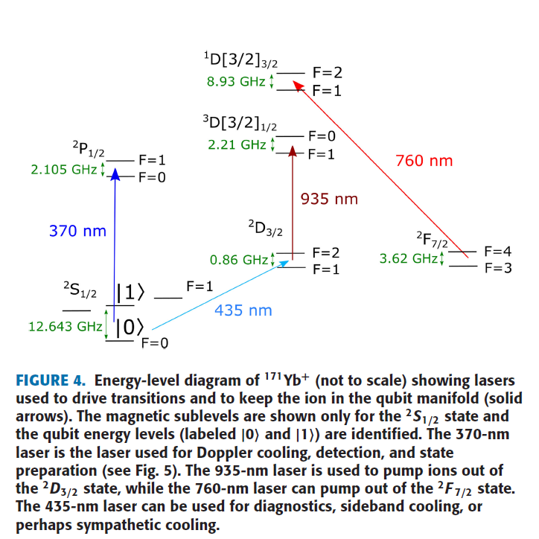
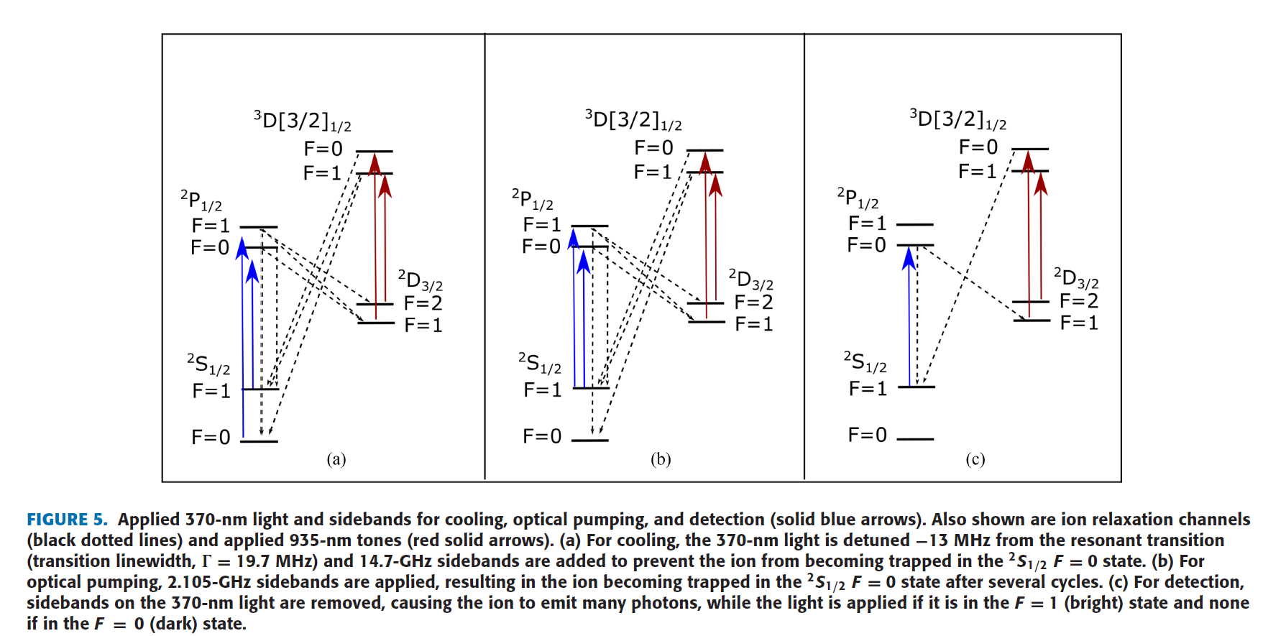
171Yb Energy Diagram
S. M. Clark, D. Lobser, M. C. Revelle, C. G. Yale, D. Bossert, A. D. Burch, M. N. Chow, C. W. Hogle, M. Ivory, J. Pehr, B. Salzbrenner, D. Stick, W. Sweatt, J. M. Wilson, E. Winrow, and P. Maunz, IEEE Transactions on Quantum Engineering 2, 1 (2021).

Slide 5
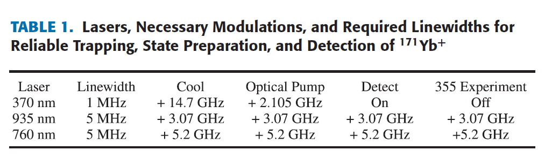
Laser frequency detuning
S. M. Clark, D. Lobser, M. C. Revelle, C. G. Yale, D. Bossert, A. D. Burch, M. N. Chow, C. W. Hogle, M. Ivory, J. Pehr, B. Salzbrenner, D. Stick, W. Sweatt, J. M. Wilson, E. Winrow, and P. Maunz, IEEE Transactions on Quantum Engineering 2, 1 (2021).

Slide 6
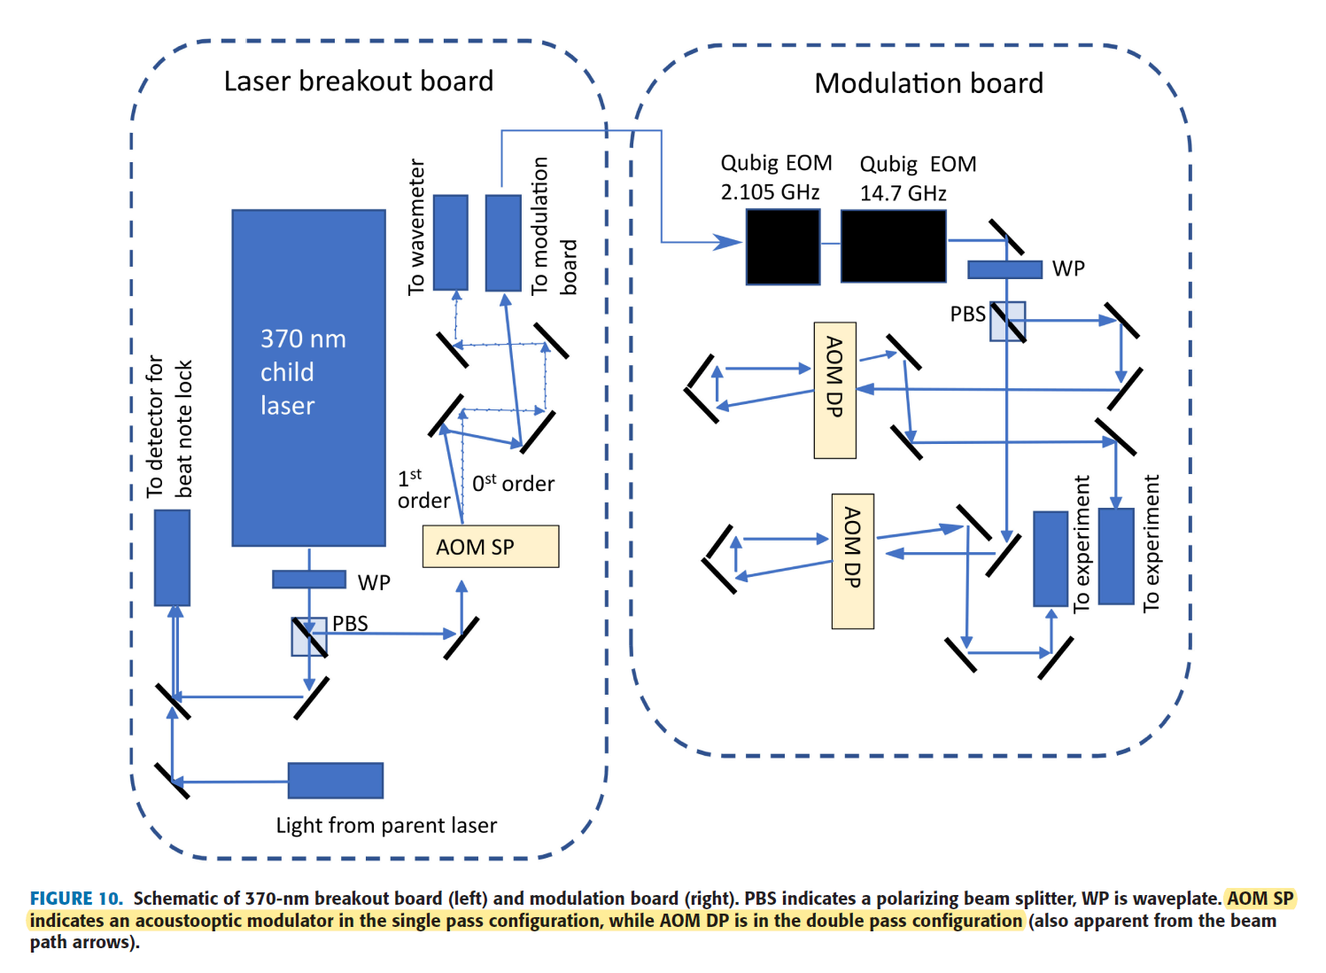
369nm setting
S. M. Clark, D. Lobser, M. C. Revelle, C. G. Yale, D. Bossert, A. D. Burch, M. N. Chow, C. W. Hogle, M. Ivory, J. Pehr, B. Salzbrenner, D. Stick, W. Sweatt, J. M. Wilson, E. Winrow, and P. Maunz, IEEE Transactions on Quantum Engineering 2, 1 (2021).

Slide 7
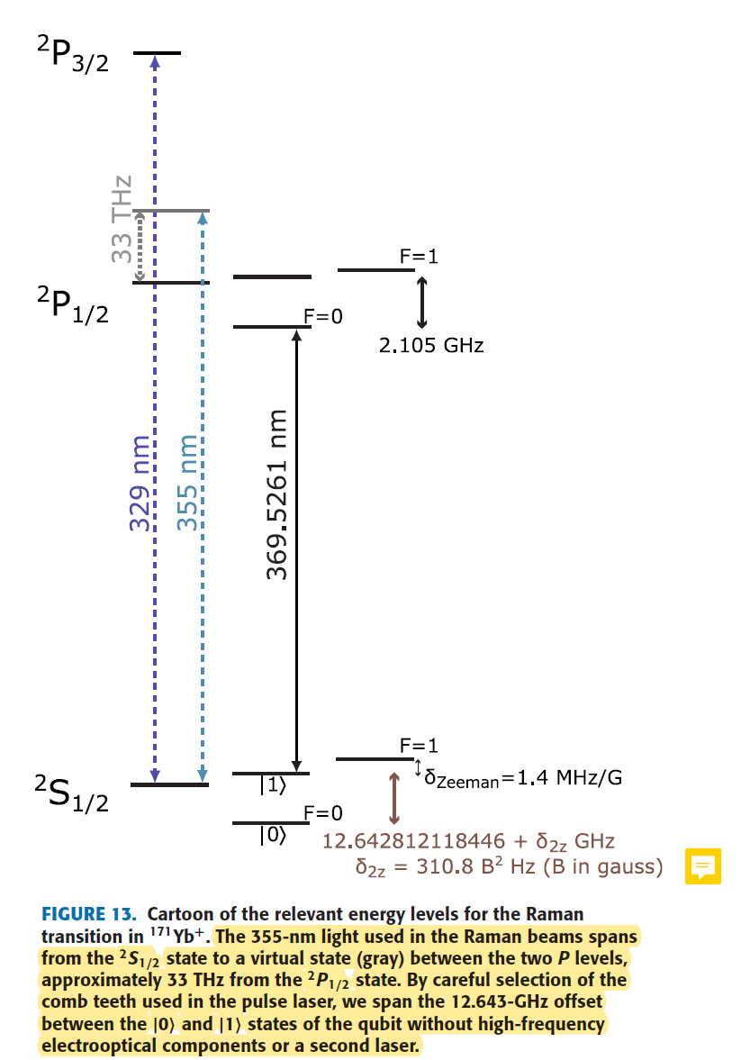
Qubit Manipulation
Two qubit gate : 12.64GHz -> can be drived by microwave
However, laser is ...
1. Tight focusing
2. Individual addressing
3. Two qubit gates mediated by phonon bus(e.g. MS gate)
S. M. Clark, D. Lobser, M. C. Revelle, C. G. Yale, D. Bossert, A. D. Burch, M. N. Chow, C. W. Hogle, M. Ivory, J. Pehr, B. Salzbrenner, D. Stick, W. Sweatt, J. M. Wilson, E. Winrow, and P. Maunz, IEEE Transactions on Quantum Engineering 2, 1 (2021).

Slide 8
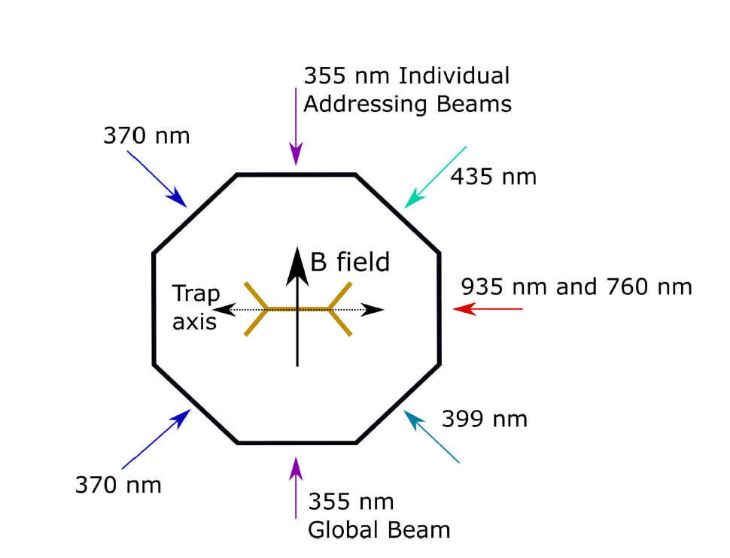
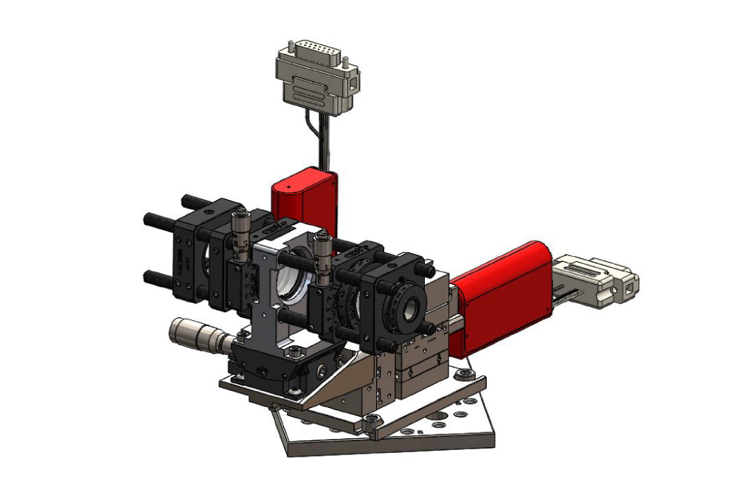
Laser Configuration
S. M. Clark, D. Lobser, M. C. Revelle, C. G. Yale, D. Bossert, A. D. Burch, M. N. Chow, C. W. Hogle, M. Ivory, J. Pehr, B. Salzbrenner, D. Stick, W. Sweatt, J. M. Wilson, E. Winrow, and P. Maunz, IEEE Transactions on Quantum Engineering 2, 1 (2021).

Slide 9
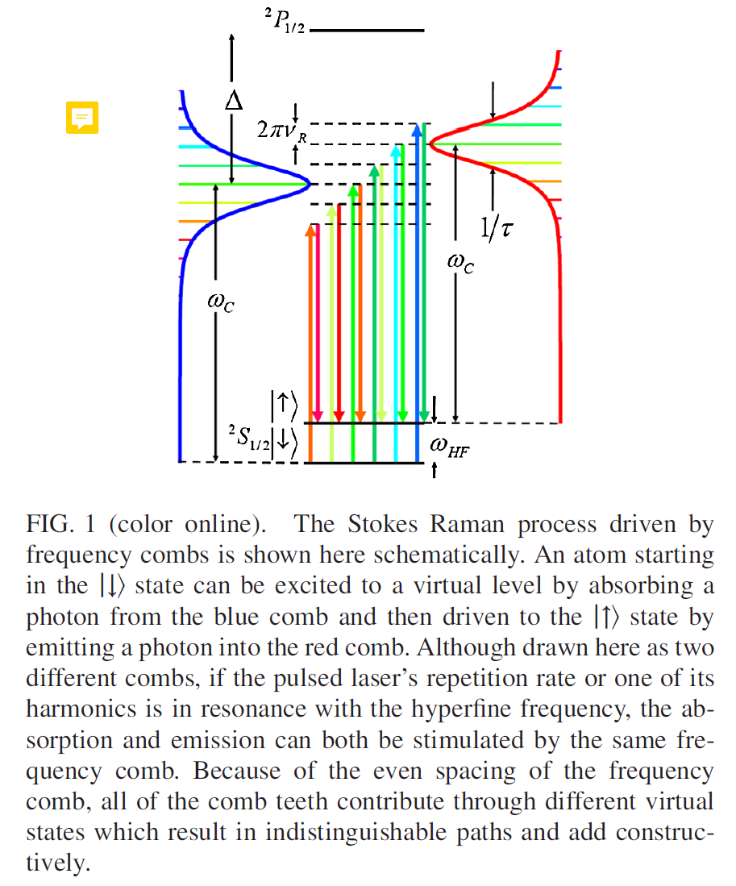
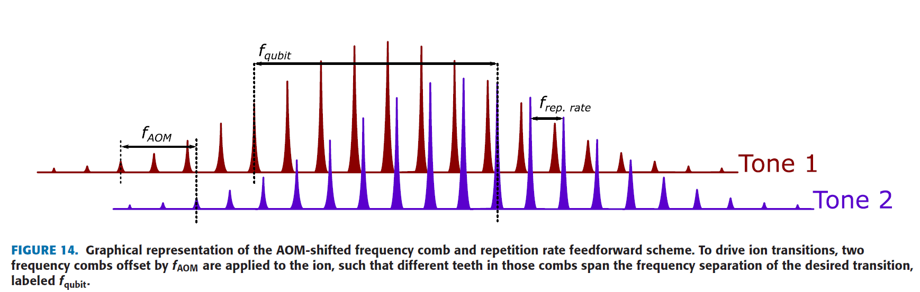
Frequency Comb
f_AOM + N(105) * f_rep(120MHz) = f_qubit
S. M. Clark, D. Lobser, M. C. Revelle, C. G. Yale, D. Bossert, A. D. Burch, M. N. Chow, C. W. Hogle, M. Ivory, J. Pehr, B. Salzbrenner, D. Stick, W. Sweatt, J. M. Wilson, E. Winrow, and P. Maunz, IEEE Transactions on Quantum Engineering 2, 1 (2021).
D. Hayes, D. N. Matsukevich, P. Maunz, D. Hucul, Q. Quraishi, S. Olmschenk, W. Campbell, J. Mizrahi, C. Senko, and C. Monroe, Physical Review Letters 104, (2010).

Slide 10
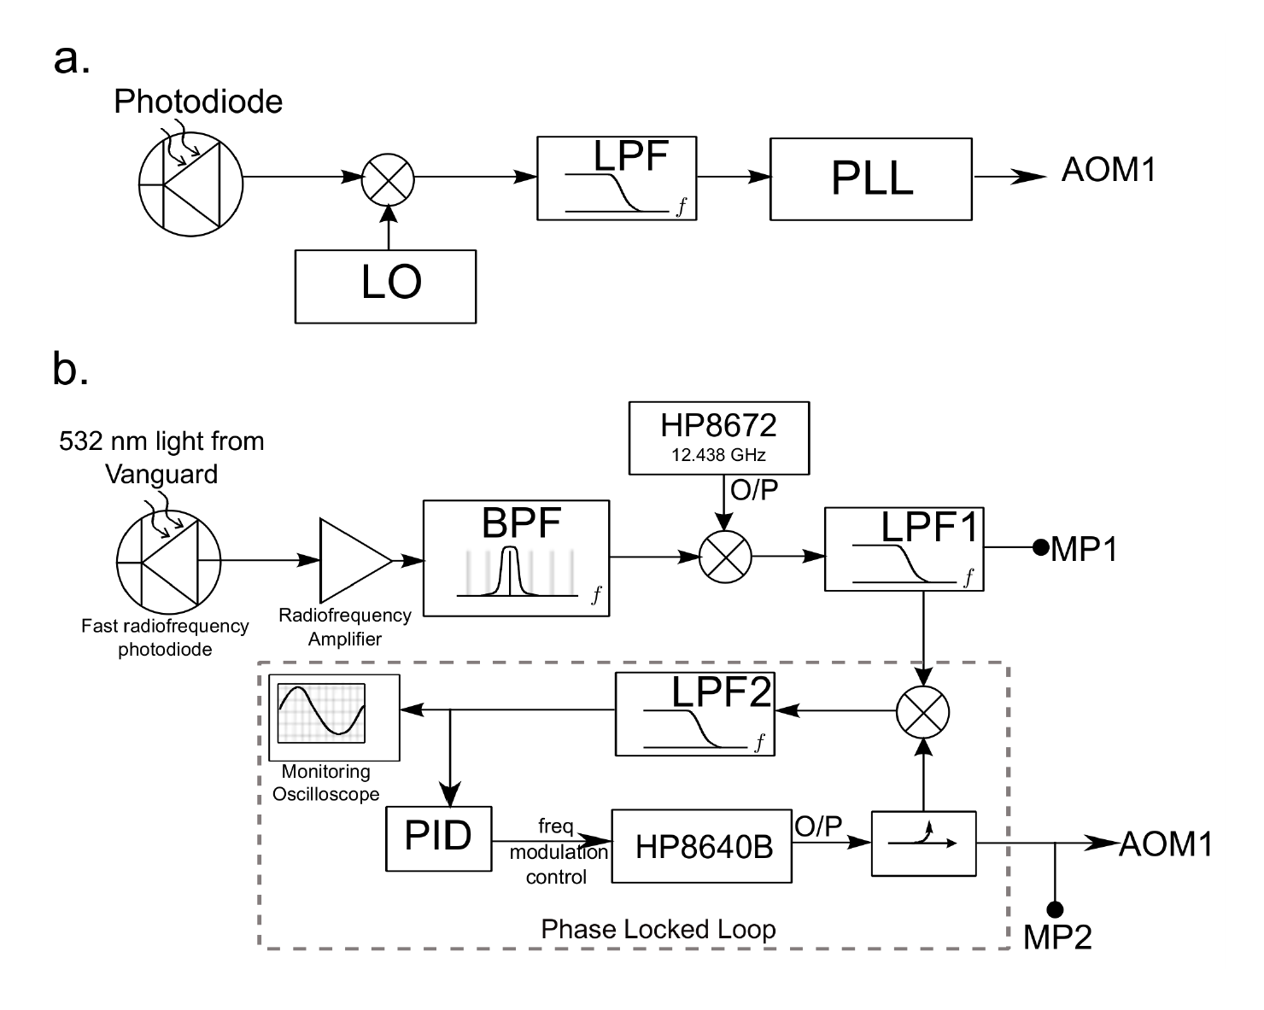
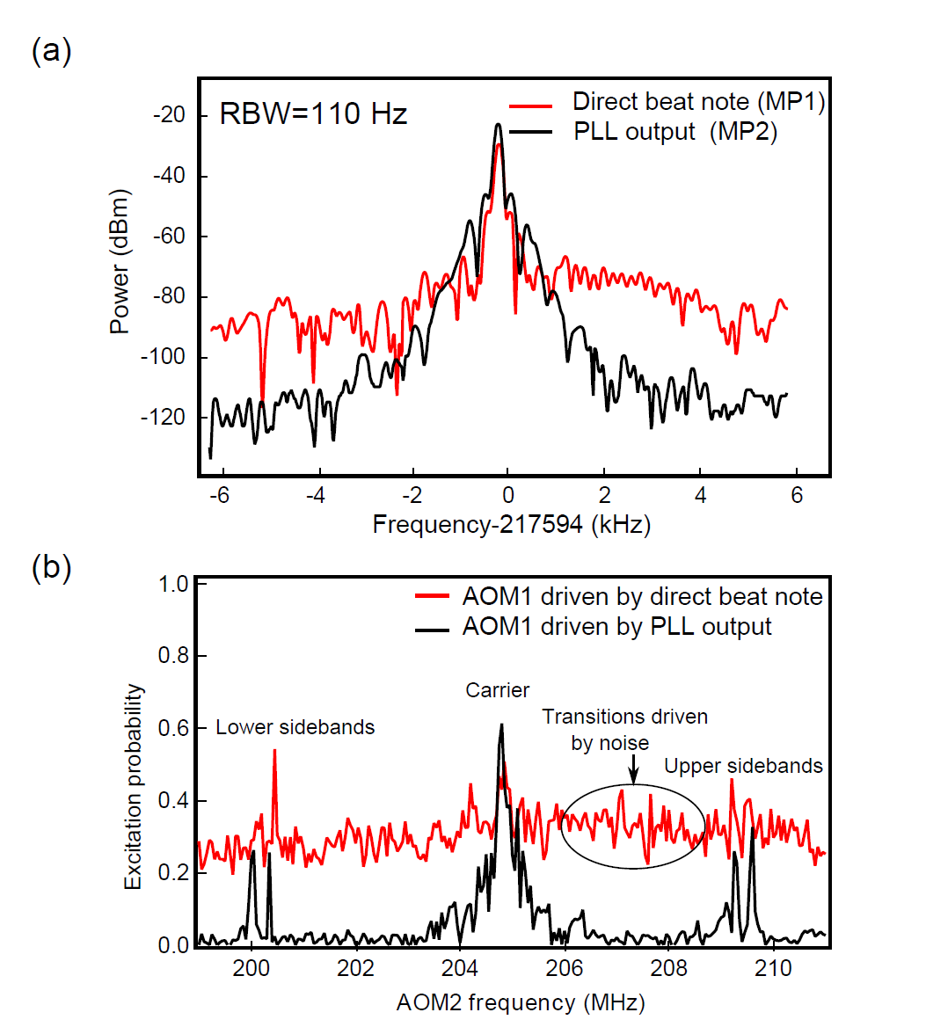
Frequency Comb Implementation
R. Islam, W. C. Campbell, T. Choi, S. M. Clark, C. W. Conover, S. Debnath, E. E. Edwards, B. Fields, D. Hayes, D. Hucul, I. V. Inlek, K. G. Johnson, S. Korenblit, A. Lee, K. W. Lee, T. A. Manning, D. N. Matsukevich, J. Mizrahi, Q. Quraishi, C. Senko, J. Smith, and C. Monroe, Optics Letters 39, 3238 (2014).

Slide 11
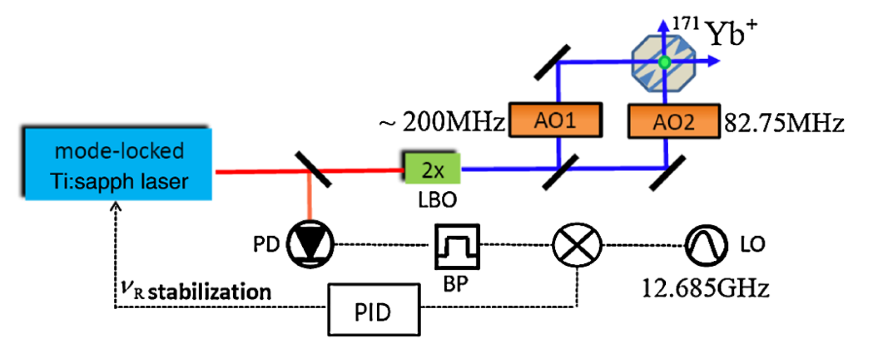
Frequency Comb Implementation(2)
D. Hayes, D. N. Matsukevich, P. Maunz, D. Hucul, Q. Quraishi, S. Olmschenk, W. Campbell, J. Mizrahi, C. Senko, and C. Monroe, Physical Review Letters 104, (2010).

Slide 12
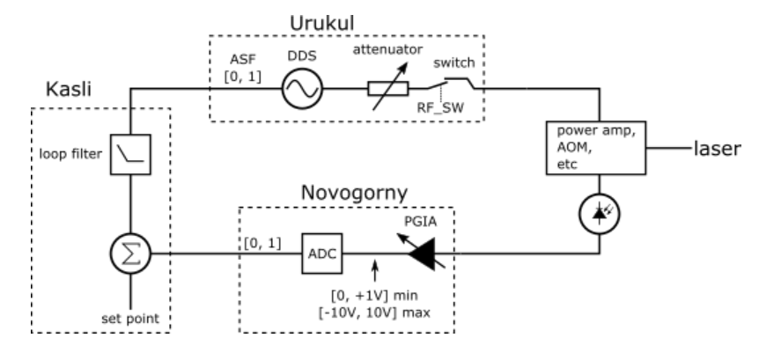
CF) Artiq Urukul Servo
PID control is implemented in PL(FPGA) side

Slide 13
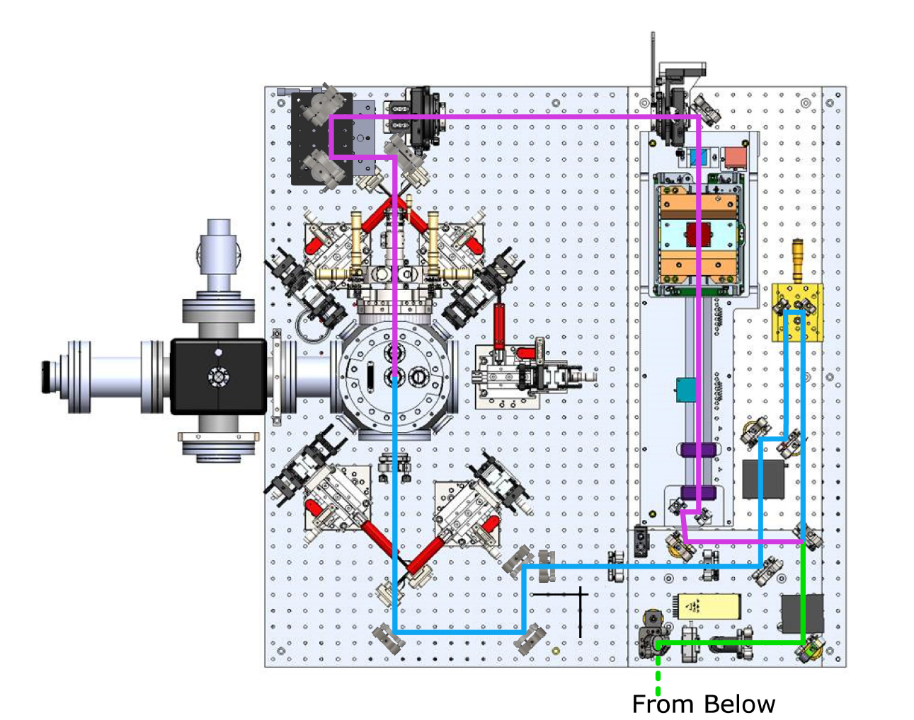
Raman Transition Setup(355nm)
Individual Beam
32Channel AOM
Global Beam
S. M. Clark, D. Lobser, M. C. Revelle, C. G. Yale, D. Bossert, A. D. Burch, M. N. Chow, C. W. Hogle, M. Ivory, J. Pehr, B. Salzbrenner, D. Stick, W. Sweatt, J. M. Wilson, E. Winrow, and P. Maunz, IEEE Transactions on Quantum Engineering 2, 1 (2021).

Slide 14
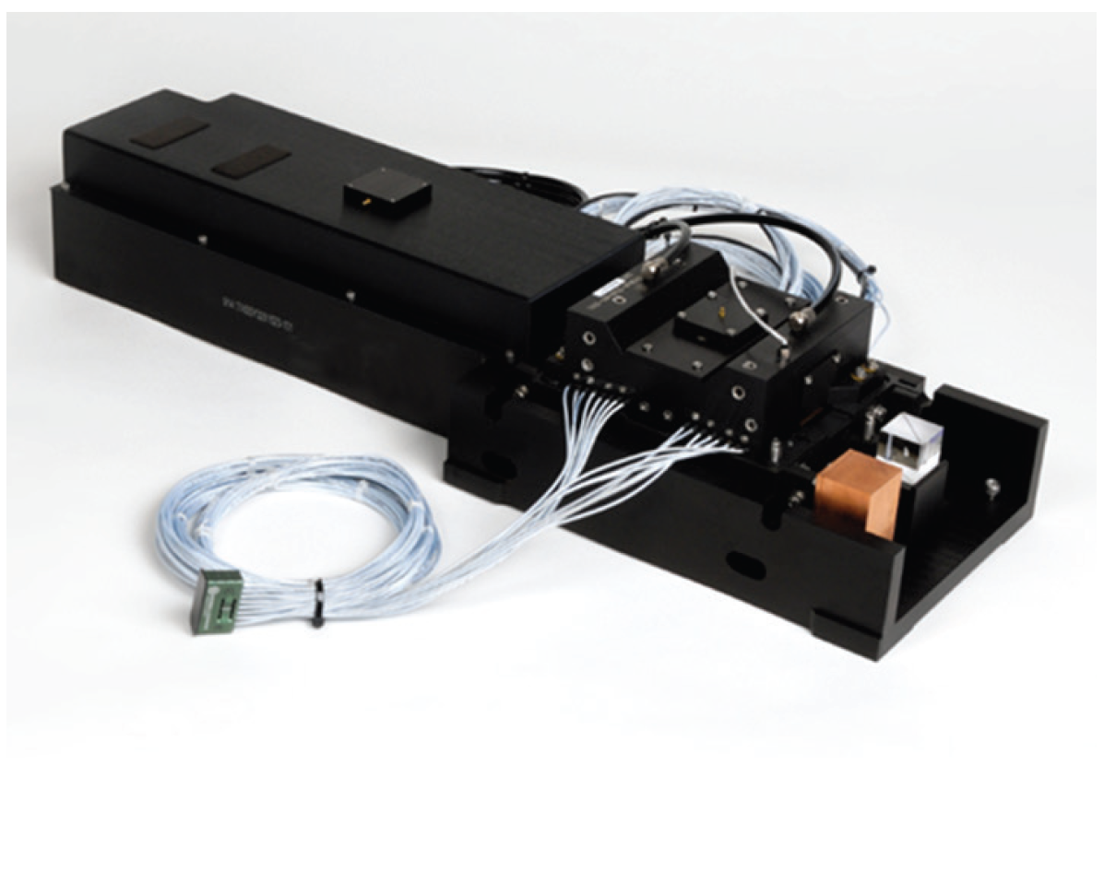
32 Channel AOM

Slide 15
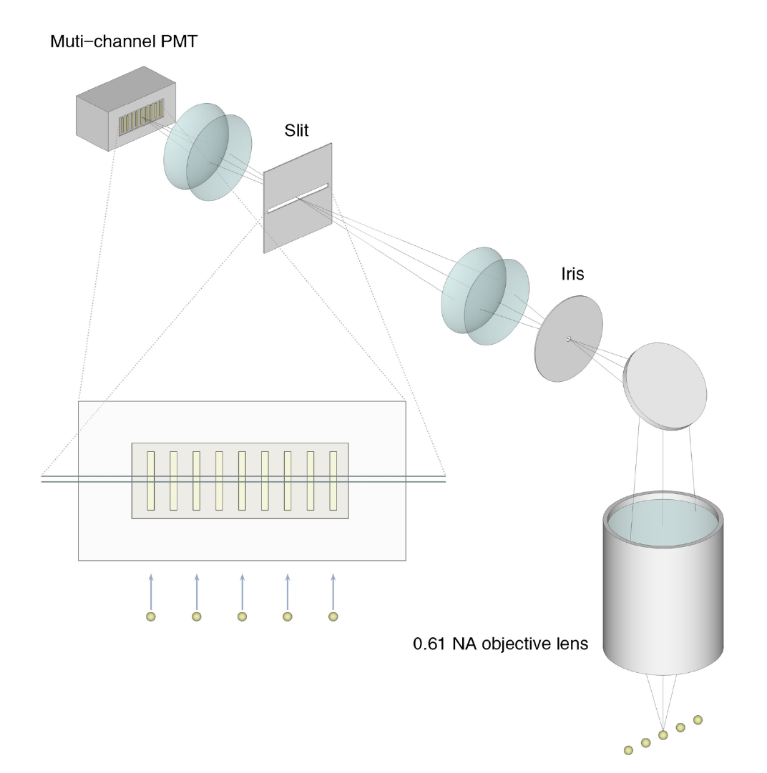
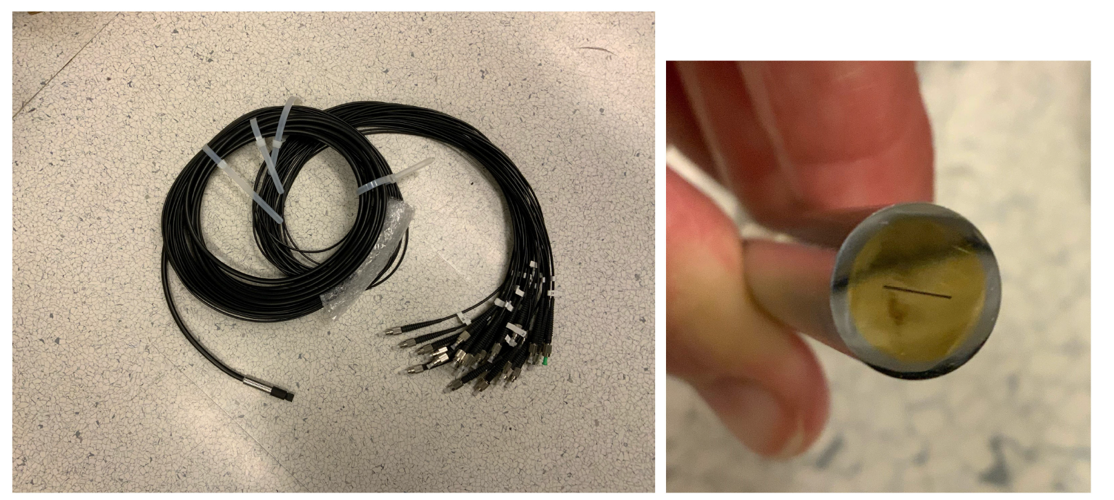
32 Channel Fiber
S. M. Clark, D. Lobser, M. C. Revelle, C. G. Yale, D. Bossert, A. D. Burch, M. N. Chow, C. W. Hogle, M. Ivory, J. Pehr, B. Salzbrenner, D. Stick, W. Sweatt, J. M. Wilson, E. Winrow, and P. Maunz, IEEE Transactions on Quantum Engineering 2, 1 (2021).
W. Chen, Y. Lu, S. Zhang, K. Zhang, G. Huang, M. Qiao, X. Su, J. Zhang, J.-N. Zhang, L. Banchi, M. S. Kim, and K. Kim, Nature Physics (2023).

Slide 16
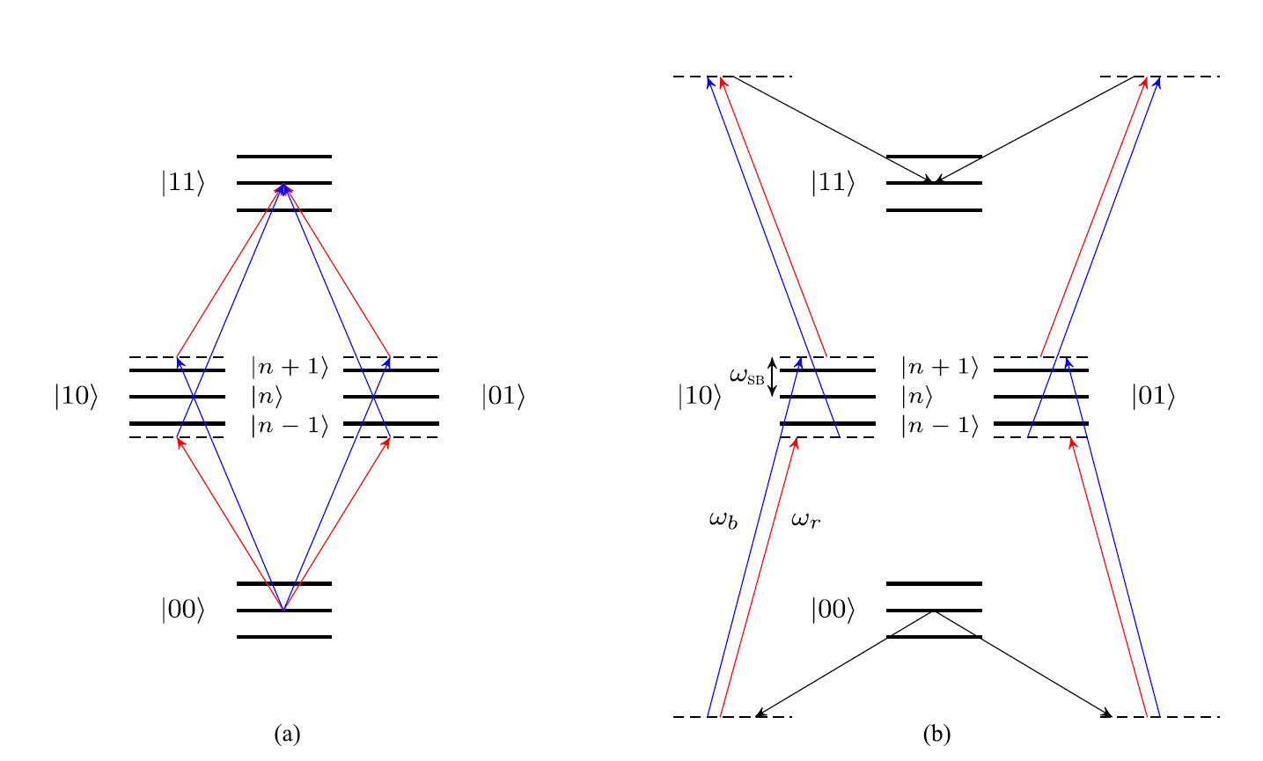
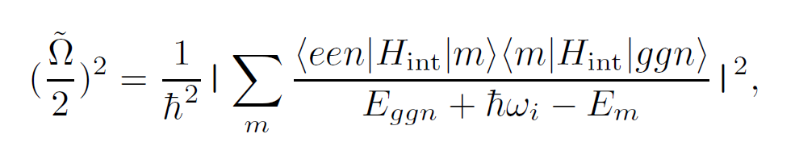
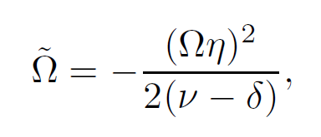
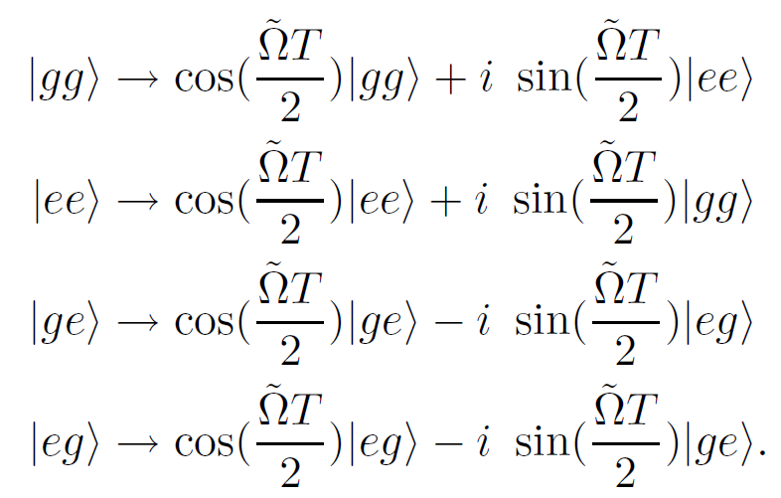
MS Gate
S. M. Clark, D. Lobser, M. C. Revelle, C. G. Yale, D. Bossert, A. D. Burch, M. N. Chow, C. W. Hogle, M. Ivory, J. Pehr, B. Salzbrenner, D. Stick, W. Sweatt, J. M. Wilson, E. Winrow, and P. Maunz, IEEE Transactions on Quantum Engineering 2, 1 (2021).
A. Sørensen and K. Mølmer, Physical Review Letters 82, 1971 (1999).

Slide 17
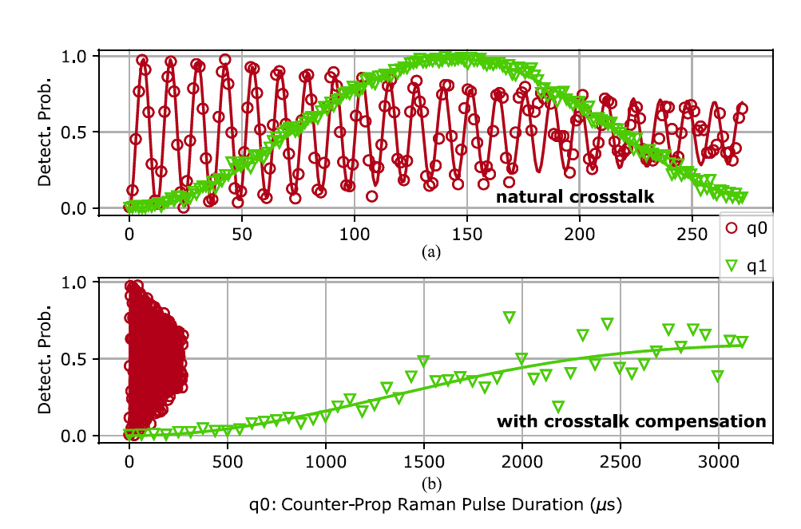
1. Static Mode
1. Crosstalk Compensation
2. Feedforward for f_rep in laser
3. Virtual Z rotation
S. M. Clark, D. Lobser, M. C. Revelle, C. G. Yale, D. Bossert, A. D. Burch, M. N. Chow, C. W. Hogle, M. Ivory, J. Pehr, B. Salzbrenner, D. Stick, W. Sweatt, J. M. Wilson, E. Winrow, and P. Maunz, IEEE Transactions on Quantum Engineering 2, 1 (2021).

Slide 18
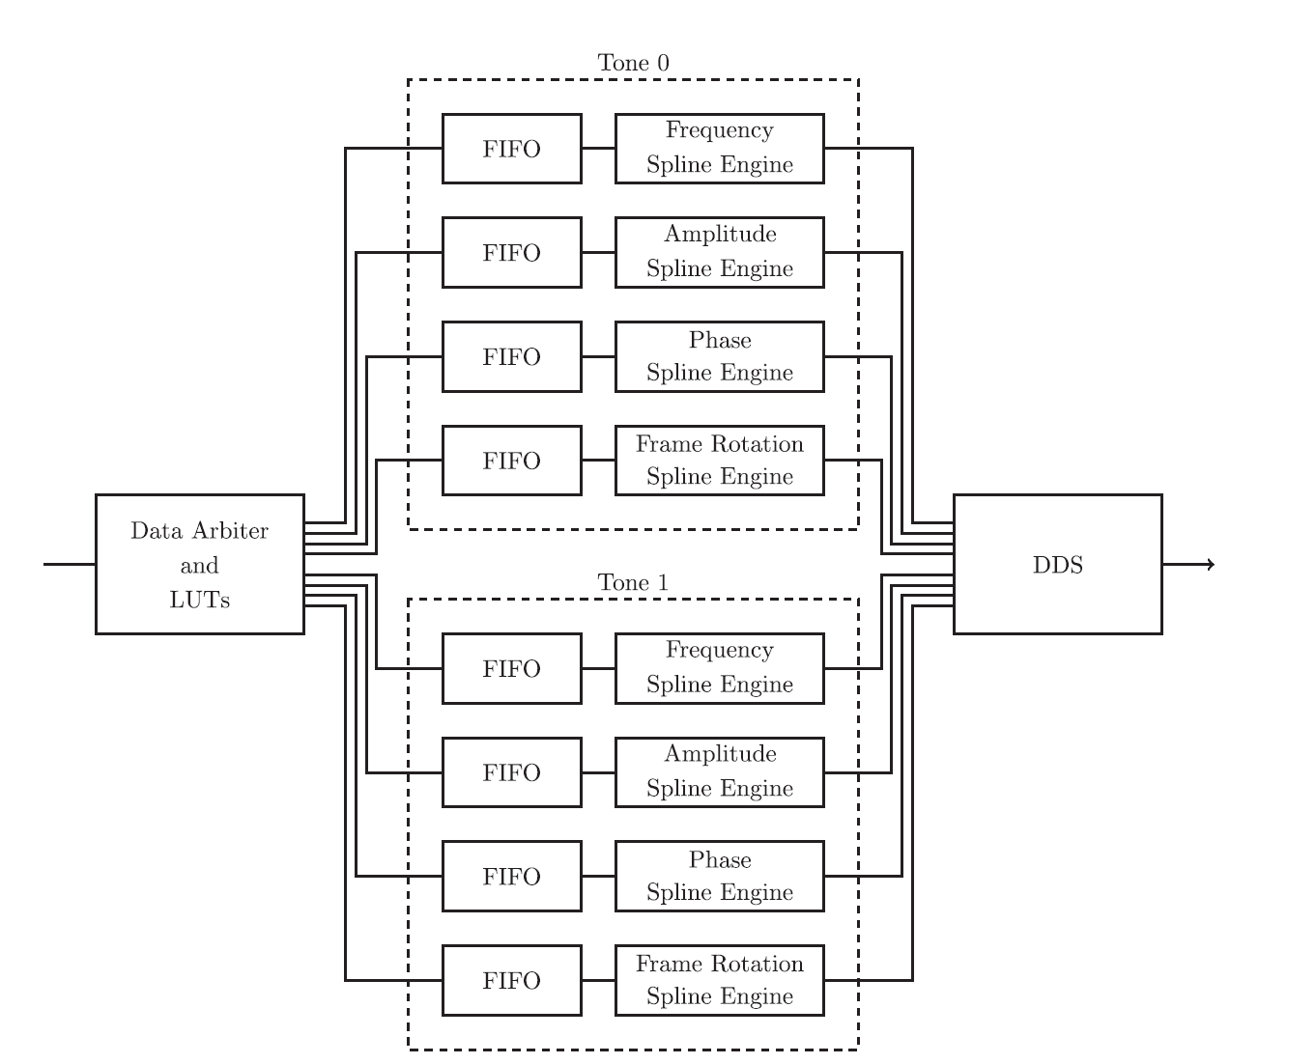
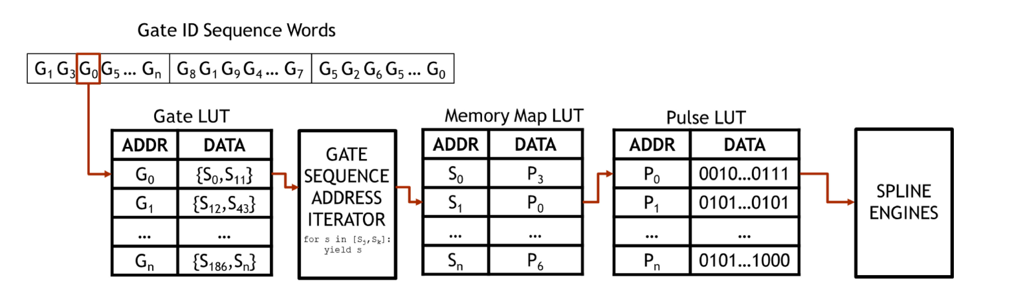
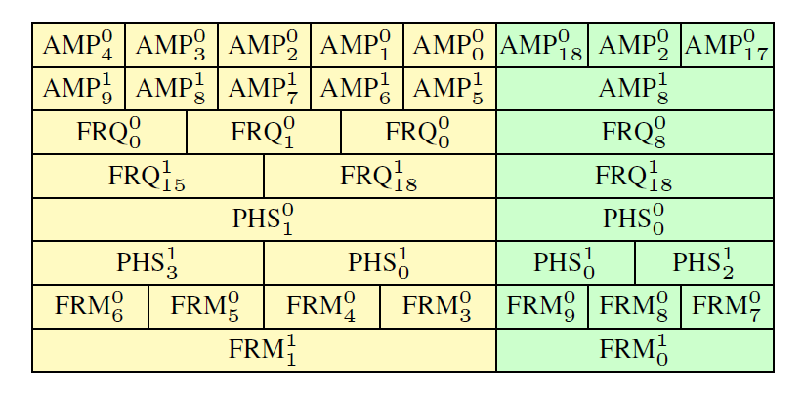
2. Dynamic Mode
S. M. Clark, D. Lobser, M. C. Revelle, C. G. Yale, D. Bossert, A. D. Burch, M. N. Chow, C. W. Hogle, M. Ivory, J. Pehr, B. Salzbrenner, D. Stick, W. Sweatt, J. M. Wilson, E. Winrow, and P. Maunz, IEEE Transactions on Quantum Engineering 2, 1 (2021).

Slide 19
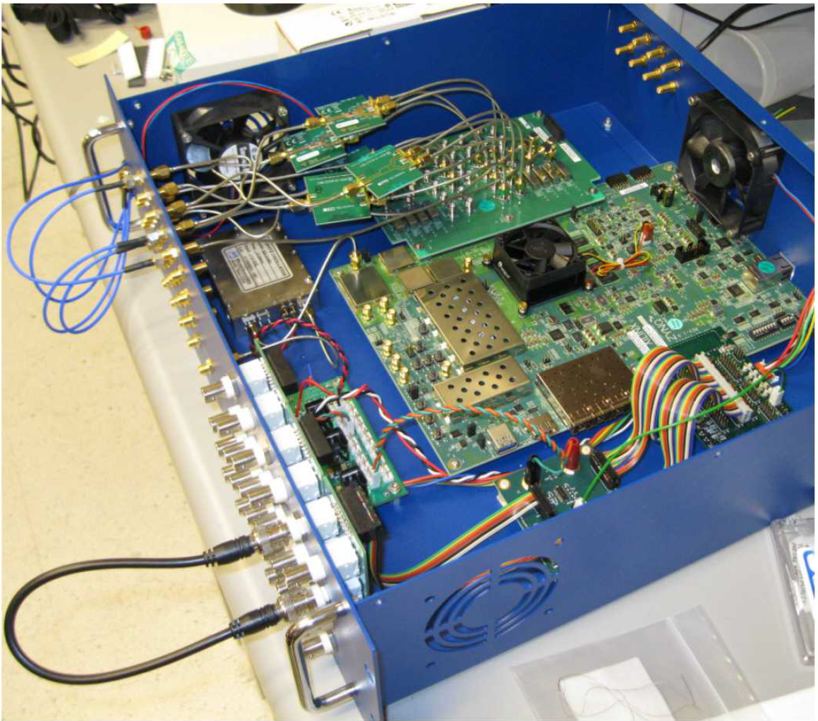
Sandia RFSoC System

